Slide 1
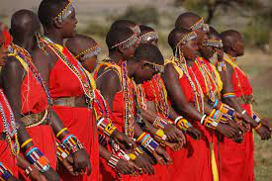
ASPECT OF AFRICAN CULTURE
ITS IMPORTANCE

Slide 2
Embracing Diversity, Unity, and Heritage
Welcome to our presentation on the importance of African culture. Today, we explore the rich tapestry of traditions, languages, arts, and values that define the diverse cultures across the African continent.
African culture is not only a source of pride and identity for millions but also a beacon of resilience and unity in a rapidly changing world.
Through this presentation, we aim to shed light on the significance of understanding and celebrating African culture, emphasizing its role in fostering unity, preserving heritage, and promoting diversity.

Slide 3
Embracing Multifaceted Traditions and Identities
Africa is home to a kaleidoscope of cultures, each with its unique traditions,
languages, customs, and beliefs.
With over 3,000 distinct ethnic groups and languages spoken, Africa boasts unparalleled cultural diversity.
From the Berbers of North Africa to the Zulu of Southern Africa, and from the Maasai of East Africa to the Yoruba of West Africa, every corner of the
continent is adorned with its own vibrant cultural tapestry.
This diversity is a testament to Africa's rich history, complex social structures,
and enduring spirit of resilience.
Visual:
Map of Africa highlighting different regions and ethnic groups.
Images depicting traditional attire, music, dance, and ceremonies from various African cultures.

Slide 4
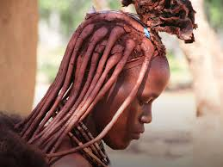
Significance of Tradition
Content:
African culture shapes identity and heritage, fostering pride and belonging.
Links past with present, preserving customs and values.
Facilitates knowledge transmission through storytelling and rituals.
Affirms unique identity, enriches global diversity.
Visual:
Images: Cultural ceremonies, family gatherings.
Elders passing down traditions to youth.

Slide 5
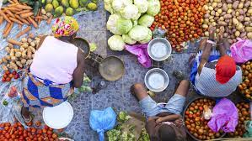
Impact Beyond Borders
Content:
African music, art, dance, and fashion resonate globally.
Literary works by African authors enrich world literature.
Culinary traditions influence cuisines worldwide.
Artifacts and artifacts displayed in museums worldwide.
Visual:
Collage of African art, music festivals, international fashion shows.
Images of famous African authors and their books.

Slide 6
Navigating Modern Challenges
Content:
Globalization threatens cultural authenticity.
Urbanization erodes traditional ways of life.
Westernization influences youth culture.
Economic disparities impact cultural preservation efforts.
Visual:
Images depicting urban sprawl, globalization symbols (e.g., skyscrapers,
fast food chains).
Photos showing cultural festivals juxtaposed with modern city scenes.

Slide 7
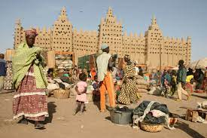
Strategies for Safeguarding Heritage
Content:
Education and awareness campaigns to promote cultural pride.
Integration of traditional practices into modern contexts.
Support for local artisans and cultural practitioners.
Legislation and policies to protect cultural sites and practices.
Visual:
Images showcasing cultural education initiatives.
Examples of successful cultural preservation projects.
Infographics illustrating the impact of policy interventions on cultural
conservation

Slide 8
Celebrating Diversity, Preserving Heritage
Content:
Recap of the importance of African culture in fostering identity and unity.
Call to action for individuals and communities to actively participate in
cultural preservation efforts.
Encouragement to embrace and celebrate the rich diversity of African heritage.
Visual:
Images symbolizing cultural unity and diversity.
Quotes from prominent cultural figures emphasizing the significance
of preserving African culture.
A collage of traditional artifacts representing various African cultures.

Slide 9
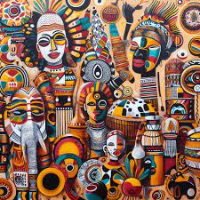
THANK YOU !

